Slide 1
DBMS Indexing
Dr. Shaheen Khatoon
Application
program
DBMS
End-user
1-<number>

Slide 2
Indexes
Primary mechanism to get improved performance on a database
Schema objects created in the database in one or more column of a table
  Persistent data structure stored in database
1-<number>

Slide 3
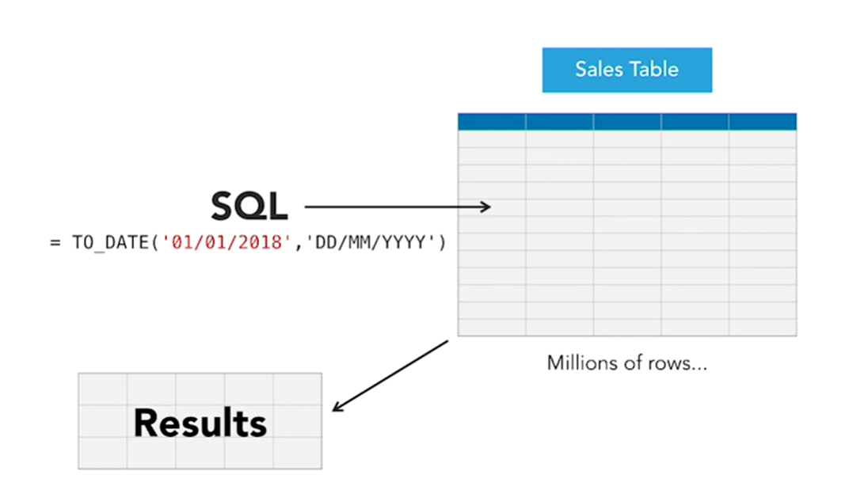
Without Index –Table Scan
Without indexes, the entire table will be scanned to find the matching row (Linear search)
The search space can be reduced by using indexes
1-<number>

Slide 4
Basic Search Demo
Linear Search or sequential scan (unordered data file)
  Average search time b/2, where b is number of blocks required to store a data file
Binary search
  If a file is ordered, Average search time log₂b
https://www.cs.usfca.edu/~galles/visualization/Algorithms.html
1-<number>

Slide 5
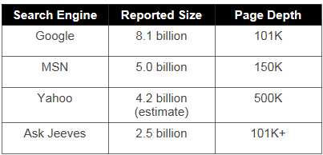
Need For Indexing: Speed
Consider searching your hard disk using the Windows SEARCH command.
  Search goes into directory hierarchies.
  Takes about a minute, and there are only a few thousand files.
Assume a fast processor and (even more importantly) a fast hard disk.
  Assume file size to be 5 KB.
  Assume hard disk scan rate of a million files per second.
  Resulting in scan rate of 5 GB per second.
Largest search engine indexes more than 8 billion pages
  At above scan rate 1,600 seconds required to scan ALL pages (Sequential Search).
  This is just for one user!
  No one is going to wait for 26 minutes, not even 26 seconds.
Hence, a sequential scan is simply not feasible.

Slide 6
Need For Indexing: Query Complexity
How many customers do I have in Nanjing?
How many customers in Nanjing made calls during April?
How many customers in Nanjing made calls to Xiamen during April?
How many customers in Nanjing made calls to Xiamen during April using a particular calling package?
Notes:
As the complexity of the queries increases, involve table joins, requires aggregates the processing time also increases correspondingly. So the problem is one of knowledge and time.
Consider a typical sales database. It will consist of a number of tables. For instance, the
customer table will consist of many rows of data, where each row is a unique customer.
The first field in each row might be the customer ID number, followed by fields
identifying first name, last name, address (that's actually several fields), phone number,
and so forth. Another table might identify products with a unique product ID and fields
identifying price, brand, inventory level, etc.
Now, imagine a simple query: how many customers are there in Riyadh? The simplest
way to do this is called a table scan: merely read every row sequentially and count the
number of times you find a CITY field containing RYD. In a large database, of course,
this will take a very long time. In this case, a simple index will greatly speed up data
access by indexing the customer table by the city field. Of course, this means that a
Database Administrator (DBA) has to create the index and keep it up to date.
Now, consider a more complex query: how many customers in Riyadh made calls during
April ? Now, the database must perform what is called a table join: it must look at both
the CALLS table, qualifying the CALL DATE field in terms of a date range, and the
Customer table, looking at the CITY field. Table joins are also very slow. In this case, a
DBA might tune the database by creating a summary table containing customer calls by
month and, again, the DBA would have to keep it up to date.

Slide 7
Need For Indexing: I/O Bottleneck
Throwing hardware just speeds up the CPU intensive tasks.
The problem is of I/O, which does not scales up easily.
Putting the entire table in RAM is very very expensive.
Therefore, index!
Notes:
Throwing more hardware at the problem doesn't really help, either. Expensive and multiprocessing
servers can certainly accelerate the CPU-intensive parts of the process, but the
bottom line of database access is disk access, so the process is I/O bound and I/O doesn't
scale as fast as CPU power. You can get around this by putting the entire database into
main memory, but the cost of RAM for a multi-gigabyte database is likely to be higher
than the server itself! Therefore we index.
Although DBAs can overcome any given set of query problems by tuning, creating
indexes, summary tables, and multiple data marts, or forbidding certain kinds of queries,
they must know in advance what queries users want to make and would be useful, which
requires domain-specific knowledge they often don't have. While 80% of database queries
are repetitive and can be optimized, 80% of the ROI from database information comes
from the 20% of queries that are not repetitive. The result is a loss of business or
competitive advantage because of the inability to access the data in corporate databases in
a timely fashion

Slide 8
Indexing Concept
  Purely physical concept, nothing to do with logical model.
  Invisible to the end user (programmer), optimizer chooses it, effects only the speed, not the answer.
  Persistent data structure, stored in database

Slide 9
Indexing Goal
Look at as few blocks as possible to find the matching record(s)
The point of using an index is to increase the speed and efficiency of searches of the database.
Without some sort of index, a user’s query must sequentially scan the database, finding the records matching the parameters in the WHERE clause.
Notes:
The point of using an index is to increase the speed and efficiency of searches of the database. Without some sort of index, a user’s query must sequentially scan the database, finding the records matching the parameters in the WHERE clause.

Slide 10
Functionality
T
Index
on T.A
 | A | B | C
1 | cat | 2 | …
2 | dog | 5 | …
3 | cow | 1 | …
4 | dog | 9 | …
5 | cat | 2 | …
6 | cat | 8 | …
7 | cow | 6 | …
 | … | … | …
T.A= ‘cow’
T.A=‘cat’

Slide 11
Functionality
T
Index
on T.A
 | A | B | C
1 | cat | 2 | …
2 | dog | 5 | …
3 | cow | 1 | …
4 | dog | 9 | …
5 | cat | 2 | …
6 | cat | 8 | …
7 | cow | 6 | …
 | … | … | …
Index
on T.B
T.B<6
4<T.B<=8

Slide 12
Functionality
T
Index
on T.A
 | A | B | C
1 | cat | 2 | …
2 | dog | 5 | …
3 | cow | 1 | …
4 | dog | 9 | …
5 | cat | 2 | …
6 | cat | 8 | …
7 | cow | 6 | …
 | … | … | …
Index
on T.(A,B)
Index
on T.B
T.A= ‘cat’
AND T.B>5

Slide 13
SQL Syntax
Create Index IndexName on T(A)
Create Index IndexName on T(A1,A2,…,An)
Create Unique Index IndexName on T(A)
Drop Index IndexName

Slide 14
Utility
  Index = difference between full table scans and
  immediate location of tuples
    Orders of magnitude performance difference
  Underlying data structures
    Balanced trees (B trees, B+ trees)
    Hash tables

Slide 15
Conventional indexing Techniques
Dense
Sparse
Primary Index vs. Secondary Indexes
Multi-level (or B-Tree)

Slide 16
Sparse Index
Index is always ordered
Two entries: Index field and block pointer
Sparse index keeps only one key per data block
Some keys in the data file will not have an entry in the index file
Sparse Index
Data File
10
10
30
20
50
30
70
40
90
110
50
130
60
150
70
170
80
190
90
210
100
230

Slide 17
Sparse Index: Adv & Dis Adv
Advantage:
  A sparse index uses less space at the expense of somewhat more time to find a record given its key
  Support multi-level indexing structure
Disadvantage:
  Locating a record given a key has different performance for different key values

Slide 18
Dense Index
Dense Index
Data File
Every key in the data file is represented in the index file
very efficient in locating a record given a key
if too big and doesn’t fit into the memory, will be expensive when used to find a record given its key
10
10
20
20
30
30
40
40
50
60
50
70
60
80
70
90
80
100
90
110
100
120

Slide 19
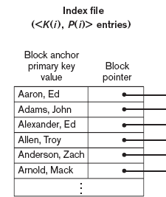
Single Level Index
A single-level index is an auxiliary file that makes it more efficient to search for a record in the data file.
The index is usually specified on one field of the file (although it could be specified on several fields)
One form of an index is a file of entries <field value, pointer to block>, which is ordered by field value

Slide 20
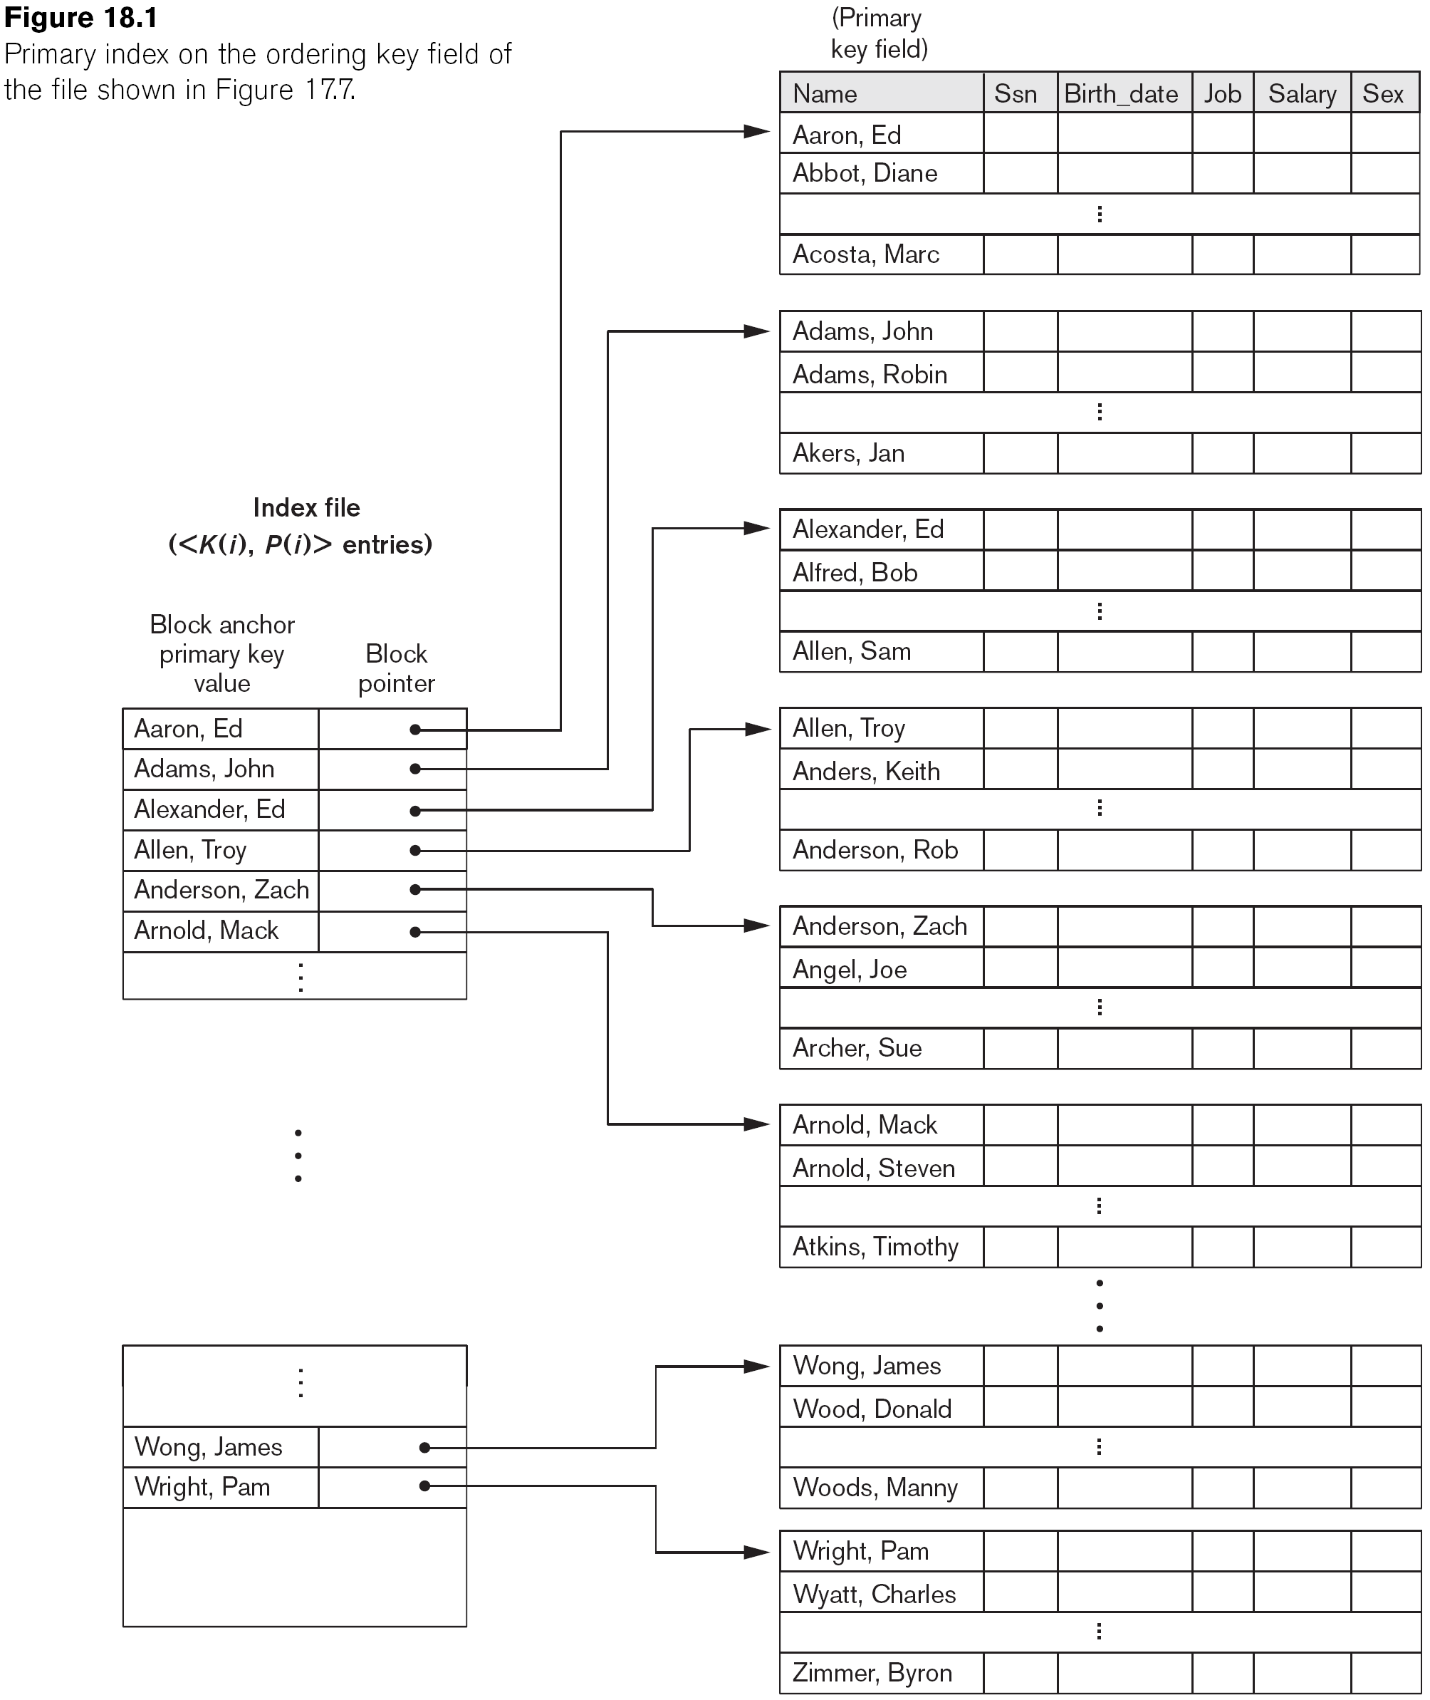
Primary Index on the Ordering Key Field
Number of entries in index file = number of block require for primary data file

Slide 21
Example: Record search without index
Example 1: Given the following data file EMPLOYEE(NAME, SSN, ADDRESS, JOB, SAL, ... ) Suppose that:
  record size R=100 bytes block size B=1024 bytes r=30000 records
Then, we get:
  blocking factor bfr=floor(B/R)= floor(1024/100)=10 records/block
  number of file blocks needed for data file b= ceiling (r/Bfr)= (30000/10)= 3000 blocks
  Average linear search cost:(b/2)= 3000/2= 1500 block accesses
  If the file records are ordered, the binary search cost would be:
    log₂b= log₂3000= 12 block accesses

Slide 22
Example: Record search with Index
For an index on the SSN field, assume the field size V_{SSN}=9 bytes, assume the record pointer size P_{R}=6 bytes. Then:
  index entry size R_{I}=(V_{SSN}+ P_{R})=(9+6)=15 bytes
  index blocking factor Bfr_{I}= B/R_{I}= 1024/15= 68 entries/block
  number of block to store index b= (r/ Bfr_{I})= (3000/68)= 45 blocks
  binary search needs log₂b_{I}= log₂45= 6 block accesses
  we need one additional block access to the data file so 6+1=7
  An improvement on binary search of data file which require 12 blocks
1-<number>

Slide 23
Multi-Level Indexes
Binary search in a single level index require a search time of order of log₂b number of block access
  Here b is the number of blocks
  If bfr (blocking factor) of index file is greater than 2, number of block access can be even reduce further
Multiple level indexes are meant for such reduction
  Contain several level of index files
  Each index at given level connect to maximum number of FO (fan out) number of block at next level
  Block access reduce from log₂b to log_{fo}b on an average for FO>2
1-<number>

Slide 24
A Two-Level Primary Index
Value >=2<35 is found index entry 2

Slide 25
Multi level index
Far ordered index file discussed so far.
  A binary search is applied to the index to locate pointers to a disk block.
  It requires (log₂b_{i}) block accesses for an index with b_{i} blocks
    because each step of the algorithm reduces the index file to search by a factor of 2.
Multilevel index is to reduce the part of the index that to search by bfr_{i}, the blocking factor for the index, which is larger than 2.
  Search space reduced much faster.
  The value bfri is called the fan-out (fo) of the multilevel index. Where it divide the record search space into n-ways (where n = the fo at each search step using the multilevel index.
Searching a multilevel index requires approximately (log_{fo}b_{i}) block accesses, smaller number than for a binary search if the fan-out is larger than 2.
1-<number>

Slide 26
Multi level index structure
First (base) level is usually primary index that is maintained in a sorted file
Second (top) level is a primary index at first level index file
We can repeat the process, creating a third, fourth, ..., top level until all entries of the top level fit in one disk block
Each level reduce the number of entries of its next level by factor of fo
If bfr_{i} = fo, entries needed at each level:
  First, level needs ⎡(r₁/fo)⎤ blocks, which is therefore the number of entries r₂ needed at the second level of the index:
    r₂₌ ⎡(r₁/fo)⎤ number of block
    r₃₌ ⎡(r₂/fo)⎤ …..
We can repeat the preceding process until all the entries of some index level t fit in a single block. This block at the tth level is called the top index level.
Single disk block is retrieved at each level, t disk blocks are accessed for an index search, where t is the number of index levels.

Slide 27
Example of multi-level index
Suppose we have a data file with r=300,000 records and each record length (R) 100 byte and block size (B) 4096 bytes
We first need to identify how many disk block is required to store the data file by calculating blocking factor for the data file
The blocking factor for the file would be bfr = ⎣(B/R)⎦ = ⎣(4,096/100)⎦ = 40 records per block.
The number of blocks needed for the file is b = ⎡(r/bfr)⎤ = ⎡(300,000/40)⎤ = 7,500 blocks.
If data file is unorder a linear search on the data file would need approximately b/2=3750 block access
If data file is ordered on some column, A binary search on the data file would need approximately ⎡log2 b⎤= ⎡(log2 7,500)⎤ = 13 block accesses
1-<number>

Slide 28
Example of multi-level index (cont…)
Now suppose that the ordering key field of the file is V = 9 bytes long, a block pointer is P = 6 bytes long, and we have constructed a primary index for the file.
The size of each index entry is Ri = (9 + 6) = 15 bytes, so the blocking factor for the index is bfri = ⎣(B/Ri)⎦ = ⎣(4,096/15)⎦ = 273 entries per block.
The total number of index entries ri is equal to the number of blocks in the data file, which is 7,500. The number of index blocks is bi = ⎡(ri/bfri)⎤ = ⎡(7,500/273)⎤ = 28 blocks.
To perform a binary search on the index file would need ⎡(log2 bi)⎤ = ⎡(log2 28)⎤ = 5 block accesses.
To search for a record using the index, we need one additional block access to the data file for a total of 5 + 1 = 6 block accesses—an improvement over binary search on the data file, which required 13 disk block accesses.
1-<number>

Slide 29
Example of multi-level index (cont…)
If we want to build a second level index on 28 blocks of first level index, we need
First level index entries =7500 and number of blocks (b1) =7500/273 = 28 block
Second level number of index entries = 28 and number of block(b2)= 28/273= less than 1 block
So in this case we can have maximum 2 level index with number of index blocks = b1 + b2=28 +1 = 29 blocks to store 2 level index
To access a record by searching the multilevel index, we must access one block at each level plus one block from the data file, so we need 2 + 1 = 3 block accesses.
Compare this to single-level index with 6 block access with the single level index
1-<number>

Slide 30
Homework
Consider a disk with block size B=512 bytes, and a record pointer is PR =7 bytes long. A file has r=30,000 EMPLOYEE records of fixed-length. Each record has the following fields: NAME (30 bytes), SSN (9bytes), DEPARTMENTCODE (9 bytes), ADDRESS (40 bytes), PHONE (9 bytes),BIRTHDATE (8 bytes), SEX (1 byte), JOBCODE (4 bytes), SALARY (4 bytes, realnumber). An additional byte is used as a deletion marker.
Calculate:
What would be number of blocks required to store this data file assuming an unspanned file organization?
On average how many blocks are required to search for a record if the data file is ordered on SSN as key field? Compare with the search performance of unordered file organization.
Suppose the file is ordered by the key field SSN and we have primary index on SSN. On average, how many blocks are required to access to search a record with this primary index on place?
1-<number>

Slide 31
Homework (cont…)
3. Suppose we want to construct multi-level index. Calculate:
  How many index entries and number of bloack required at each levels needed to make it multilevel index?
  How many blocks required to store the multi-level index, and how many blocks need to search a record with multi-level index?
1-<number>

Slide 32
Multi level index structure
Search, A multilevel index reduces the number of blocks accessed when searching for a record, given its indexing field value.
Insertions and deletions, cause severe problem because all index levels are physically ordered files.
  The updating overhead of multi-level index is high because we have to reorganize all index files every time there is a delete or insert operation in the database.
A multilevel index called a dynamic multilevel index that leaves some space in each of its blocks for inserting new entries and uses appropriate insertion/deletion algorithms for creating and deleting new index blocks when the data file grows and shrinks.
It is implemented by using data structures called B-trees and B+-trees,
1-<number>

Slide 33
Summary
Indexes
Single Level Indexes
Multilevel Indexes

